Slide 1
Leading a Healthy Lifestyle
SHARAN .N
NEERAJ S GOWDA
MANASA S RAO
G HARSITHA

Slide 2
Aims of the presentation
To inform and discuss what a ‘healthy lifestyle’ means
To help you identify health behaviours you could incorporate into your lifestyle
To answer your questions on a healthy lifestyle

Slide 3
‘The Holy Four’
Some researchers termed the following the holy 4 as they have a big impact on disease;
Smoking
Drinking
Nutrition
Physical Activity

Slide 4
Exercise can be a walk in the park!
A 30 minute
Brisk walk
Jogging
Cycling
Heavy gardening/housework
…on >5 days a week
If it gets you slightly out of breath and a bit sweaty its working!
Two 15 minute bursts may be just as effective

Slide 5
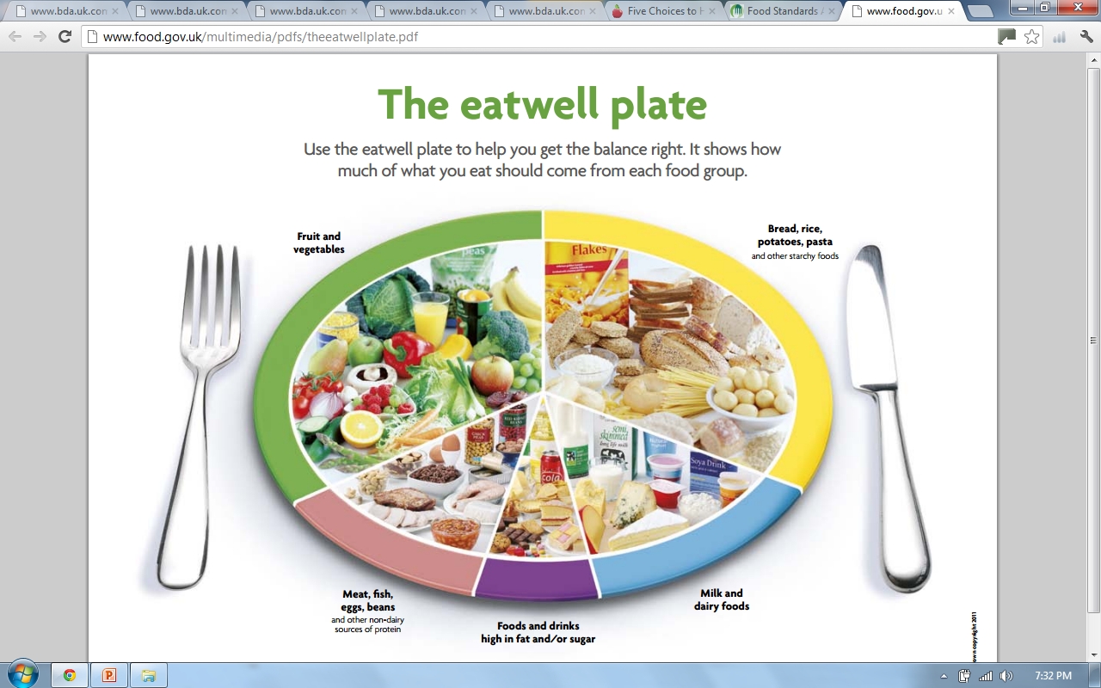
Notes:
The eatwell plate shows how much of what most adults eat should come from each food group. This includes everything you eat during the day, including snacks. So, try to eat: – plenty of fruit and vegetables – plenty of bread, rice, potatoes, pasta and other starchy foods – choose wholegrain varieties whenever you can – some milk and dairy foods – some meat, fish, eggs, beans and other non-dairy sources of protein – just a small amount of foods and drinks high in fat and/or sugar

Slide 6
33% Starchy carbohydrates
Bulk of meals
33% Fruit & Vegetables
5+ a Day
15% Milk & Dairy
3 portions daily
12% Meat, Fish, Eggs, Beans
Oily fish once a week
<8% High fat/sugary foods
Avoid saturated fats
Proportions taken from food.gov.uk website
Notes:
-Should get all the vitamins and minerals you need from eating a balanced diet meaning most people don’t need a multivitamin supplement
-Most meals we eat are ‘composite/combination’ ones, made up of a mixture of food groups, i.e. sandwich, casserole, pasta dishes. Need to consider how much of each food group the meal consists of and check if your intakes fitting with the suggested proportions

Slide 7
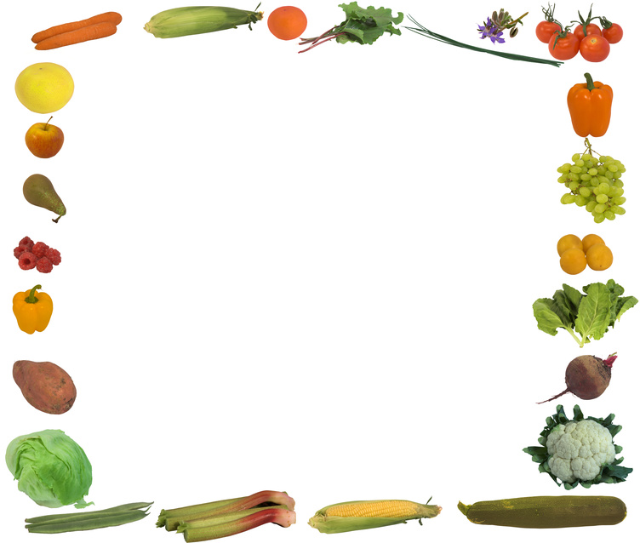
Why 5 a Day?
400g fruit and vegetables a day can help us to stay healthy
Great source of antioxidants, vitamins and minerals
Make a good healthy, handy and sometimes cheap snack i.e. banana 19p!
Help to prevent constipation due to their high dietary fibre content
May reduce risk of cancer, heart disease and stroke
Notes:
Antioxidant – a substance that protects our cells from oxidative damage (i.e. it prolongs the health of our cells). This diet provides a healthy intake for our whole body system, even down to our individual cells!

Slide 8
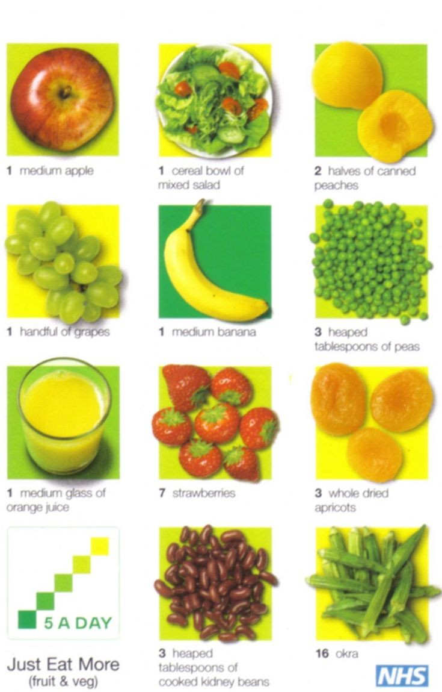

What Counts?
Fresh
Frozen
Tinned
Canned
Dried
Shows a product contains a number of 5 a day
Notes:
How many squares filled in shows how many portions of fruit or veg a product provides
Variety is key
Healthy adults should try to avoid consuming fruit and veg with added fat i.e. cream with fruit or butter on veg. fat free yoghurt accompanies fruit well. Also to note that over boiling veg can destroy their vitamin c content.

Slide 9
Carbohydrates
Q: What are they?
A: Sugars and starches that provide our bodies with energy (calories) to function
Dietary sources come in two forms;
Simple
Fructose (fruit sugar), sucrose (table sugar), lactose (milk sugar) and glucose
Sweets, sugary pop
Complex/starchy
Bread, flour, rice, pasta, breakfast cereals
Good source of calcium, iron and B vitamins
Notes:
Simple carbs have 1 or 2 units of sugar. Easier for body to break down to glucose so get absorbed into blood quicker
Complex/starchy made of many units of sugar. Take longer to be metabolised so they provide a slower release of energy.

Slide 10
Fruit and vegetables and pulses also provide carbohydrates; a mixture of starches and sugars
Recommended dietary intake: 33% starchy carbs, 50% total carbs
Our bodies store unused carbohydrate in the liver and muscles but when full, excess carbohydrate is stored as fat
Too little carbs → weakness, poor concentration (not enough fuel to the brain), constipation
Notes:
-XS CHO stored as fat, highlights why we need to eat it in the right proportions

Slide 11

Whole grains
Wheat, barely, rye, oats and rice
3 layers;
Fibre rich outer layer (bran)
Nutrient packed inner area (germ)
Central starchy part (endosperm)
Processing removes the bran and germ → white variety
Surveys show 95% of adults don’t consume enough
Soluble & non-soluble fibre to prevent constipation, lower cholesterol and encourage healthy gut bacteria
Notes:
The grain is the seed of these cereal crops
By removing the bran and germ (white bread, pasta, rice etc) you can see that a lot of the fibre and nutrients including B and E vitamins are removed
Fibre reduces transit time therefore reducing the time when damaging substances may be in contact with the gut wall whilst providing a thriving environment for good bacteria which produce gut protective substances

Slide 12
May risk of type 2 diabetes, heart disease and some cancers
Aim for 3 servings daily
Low ‘GI’ (slow release of energy) which may keep you fuller for longer
Look out for ‘Whole’ before the name of the cereal
Ideas:
Wholegrain cereals and cereal bars with yoghurt or milk for breakfast or as snacks
Wholemeal, granary, multigrain bread instead of white
Oatmeal and whole-oats to make flapjack
Quinoa, bulgur wheat, brown rice in salads or with curries

Slide 13
Protein: Meat, Fish and Alternatives
Moderate amounts
Choose low fat/lean options where possible
Cut visible fat off meat products and avoid poultry skin
Try avoid processed meat products due to their high saturated fat content
Fish twice a week (not fried!), one oily
Eggs – FSA puts no limit on intake
Mycoprotein (QuornTM), soya protein and tofu are also good low fat protein sources
Notes:
-Poultry meat has increased considerably in fat content over recent years. White breast meat with no skin has the least amount of fat.
- Omega 3 sources in descending order of quantity of omega 3
- Eggs contain dietary cholesterol however this has little effect blood cholesterol levels

Slide 14
Protein: Milk and Dairy
2-3 portions daily
Milk (1/3 pint), cheese (40g), yoghurt (1 pot)
Healthy adults should choose low fat options if possible
Plant based alternative milk drinks i.e. soya better to get fortified sugar free version
Snack/dessert idea:
Try plain yoghurt with strawberries or blueberries for sweetness or adding it to curries instead of cream
Notes:
Low fat dairy products contain the same amounts of calcium and protein as their full fat alternatives but less fat and energy
Research suggests soya milk may be beneficial in lowering bad cholesterol

Slide 15
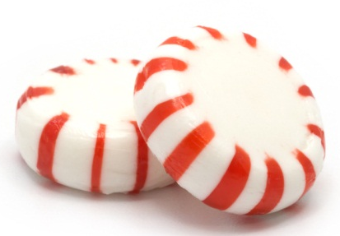
High Fat/Sugary Foods
<8% of intake
Can be consumed as part of a healthy balanced diet
Include crisps, sweets, cakes, biscuits, sugary drinks
Provide relatively little nutritional benefit
Many are highly processed so may contribute a large amount of salt to the diet

Slide 16
Fat
We need some fats in our diet as they provide energy and some vitamins. Some our body cannot make; essential fatty acids (EFAs)
Saturated (animal products)
Trans (cakes/biscuits)
↑ blood cholesterol
Monounsaturated (olive/rapeseed oils, avocados)
Polyunsaturated (sunflower, corn, sesame oil)
↓ blood cholesterol
Notes:
Saturated – hard at room temp
Trans – veg oils that have been processed to make them hard (on ingredients list as partially hydrogenated veg oil)
It is recommended to reduce sat & trans fats and increase mono and polyunsaturated fats for heart and overall health.

Slide 17

Omega 3
EFAs: our body cannot make them so we have to obtain them through dietary sources
Sardines
Salmon
Mackerel, kippers
Herrings
Tuna
Swordfish
Halibut, trout
Plant sources linseed, walnuts and walnut oil
Healthy Heart
Notes:
Tinned tuna – canning process removes omega 3

Slide 18
How to saturated fat intake
Grill, boil, steam or poach instead of frying and roasting
Cutting off all visible fat, removing poultry skins, skim fat off mince from casseroles
Use an olive based or low fat spread instead of butter
Choose lower fat dairy products
Keep hidden sources of saturated fat to a minimum i.e. biscuits, pies etc.

Slide 19
Salt is falling, all around us
Consuming too much salt in our diet can lead to high blood pressure → risk of heart disease and stroke
Lots of foods have hidden salt – check labels
Current average intake is
8.6g (2 tsp)
Recommended: 6g
~ 75% of salt is hidden in food already!
Ready meals, soup, sauces, cereals, crisps
stock cubes, processed meats, smoked fish
Notes:
Lowering salt intake it is possible to reduce your blood pressure and therefore reduce your risk of developing heart disease and stroke

Slide 20
Tips to reduce salt intake
Don’t add during cooking or at the table
Use herbs and spices or lemon juice
Look at labels, check for lower salt varieties
Ask in restaurants for no salt
2 weeks no salt – taste buds can adjust so persist

Slide 21
Meal Pattern
Regular balanced meals are recommended
Missing meals may result in higher quantities of high energy foods being craved and consumed
Plan ahead
Meal times are a good opportunity to get the family together
‘Breakfast is the most important meal of the day’ - break the fast!
people who consume a fortified breakfast cereal tend to have higher intakes of vitamins and minerals

Slide 22
Watch your Weight
After eating we should feel satisfied, not stuffed!
Measurement of weight to height used by most health professionals;
- BMI (Body Mass Index)
A BMI outside of the desirable 20-25Kg/m² may reflect a higher risk of developing health problems

Slide 23
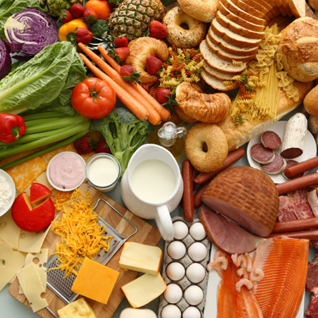

Aim to lose weight slowly (1-2 pounds/week)
Input V Output
Base intake on the Eatwell Plate
Notes:
A 500Kcal reduction in energy daily can result in healthy weight loss of 1-2lbs

Slide 24
The Media
Health claims often reported
in the media
Sponsored studies → biased results
Sample sizes of the test group may be small so the results can’t be generalised to everyone
Financial gain? Some products expensive
Be critical, may have to take with a (small) pinch of salt!

Slide 25
Summary
Hopefully now you feel informed about what a ‘healthy lifestyle’ means and are able to identify health behaviours you could incorporate into your lifestyle
Eat sensibly, choosing a range of foods in the correct proportions
Move often
Drink moderately
If you smoke, try to stop
Notes:
If you would like more in depth, tailored advice about your diet or specific medical condition ask your GP to refer you to a dietitian

Slide 26
Thank you for listening
Any questions?

